Slide 1
Classes and Objects

Slide 2
Primitives
Single-valued data items. Not Objects
byte 8-bit signed two's complement integer
short 16-bit signed two's complement integer
int 32-bit signed two's complement integer
long 64-bit signed two's complement integer
float 32-bit single-precision IEEE 754
double 64-bit single-precision IEEE 754
boolean true/ false
char 16-bit Unicode character

Slide 3
The number of bits and the range of values Two's complement integers, n=4
0000 0
0001 1
0010 2
0011 3
0100 4
0101 5
0110 6
0111 7
1000 -8
1001 -7
1010 -6
1011 -5
1100 -4
1101 -3
1110 -2
1111 -1
2^{n-1}
0 .. (2^{n-1})-1 = 0 .. 7
2^{n}
-(2^{n-1}).. (2^{n-1})-1
2^{n-1}
(2^{n-1})..-1 = -8 .. -1

Slide 4
The number of bits and the range of values Two's complement integers, n=32
-(2^{n-1}).. (2^{n-1})-1
-(2³²⁻¹).. (2³²⁻¹)-1
-(2³¹).. (2³¹)-1
-2,147,483,648 .. +2,147,483,647
-OR-
2¹⁰ = 1,024 or about 1,000 (Kilo)
2²⁰ = 1,024² or about 1,000,000 (Mega)
2³⁰ = 1,024³ or about 1,000,000,000 (Giga)
2⁴⁰ = 1,024⁴ or about 1,000,000,000,000 (Tera)
2³¹ = 2¹ * 2³⁰
= 2 G (about 2 billion)
So, an integer can represent +/- 2 billion

Slide 5
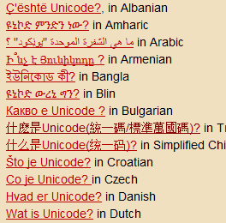
char
ASCII 8-bit code 2⁸ = 256 chars
Unicode 16-bit code 2¹⁶ = 2⁶ *2¹⁰= 64,000 chars
http://www.unicode.org/charts/

Slide 6
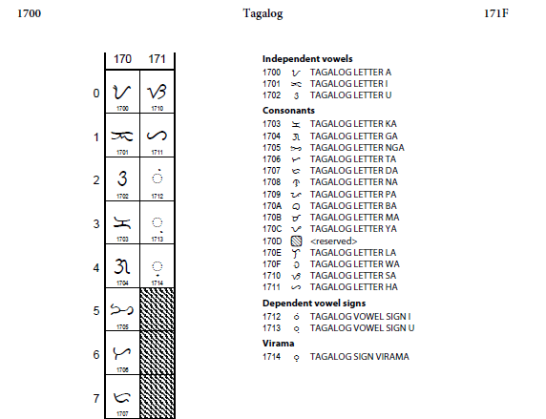

Slide 7
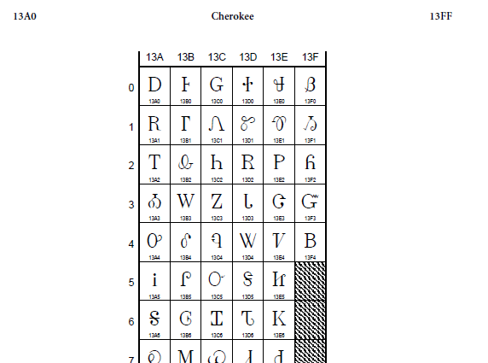

Slide 8
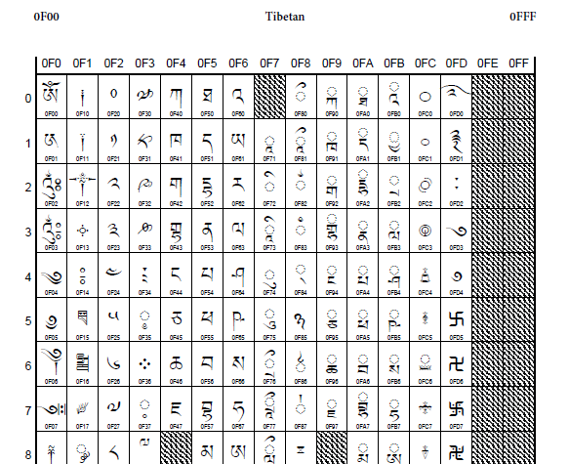

Slide 9
Class
a blueprint or template that describes the properties and behaviors of an object.
Object
an instance of a class which has specific properties

Slide 10

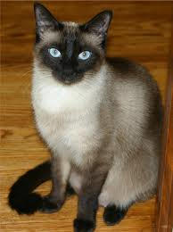
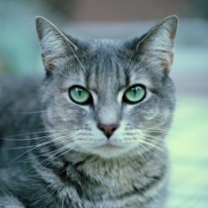

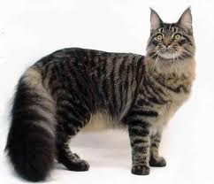
Example:
class Cat
Properites: breed, gender, color, number of legs,
neutered,…
Behaviors: meows, eats, purrs, sleeps, …
A specific cat is an instance of the Cat class:
Cat
Breed: tabby
gender: male
Color: gray
Number of legs: 4
Neutered: yes
Breed: calico
gender: female
Color: brown
Number of legs: 4
Neutered: yes
Breed: Maine Coon
gender: male
Color: gray
Number of legs: 4
Neutered: yes
Breed: Siamese
gender: female
Color: sable
Number of legs: 4
Neutered: yes

Slide 11
Instantiation- making an instance of a class
Cat pet1, pet2, pet3;
pet1 = new Cat("tabby","male","gray",4,true);
pet2 = new Cat("calico","female","brown",4,true);
pet1
pet2

Slide 12
Static vs. Instance
Static variables belong to a class.
There is only ONE variable for EVERY instance of the class.
Instance variables belong to an object
The object is an instance of the class.
Example:
The color and gender of a cat depends on the instance of the cat.
The number of legs is a property of all cats.

Slide 13
class Cat {
static int NUMBER_OF_LEGS = 4;
String gender;
String breed;
String color;
boolean neutered;
}
Cat
NUMBER_OF_LEGS

Slide 14
Cat
int leg = Cat.NUMBER_OF_LEGS;
NUMBER_OF_LEGS is static so its value
comes from the class Cat
String myCatBreed = pet1.breed;
breed is an instance variable so its value
comes from a particular instance of a Cat
NUMBER_OF_LEGS
pet1

Slide 15
Can static variables be changed?
Yes.
class Cat {
static int numberOfCats = 0;
static int NUMBER_OF_LEGS = 4;
String gender;
String breed;
String color;
boolean neutered;
public Cat (…) {
numberOfCats++;
}
}
pet1 = new Cat(…); //numberOfCats is now 1
pet2 = new Cat(…); //numberOfCats is now 2

Slide 16
Use the final modifer to make constants.
class Cat {
static int numberOfCats = 0;
static final int NUMBER_OF_LEGS = 4;
String gender;
String breed;
String color;
boolean neutered;
public Cat (…) {
numberOfCats++;
}
}

Slide 17
methods
methods (functions in C++) define the behavior of an object.
A Cat object could tell you its breed:
public String getBreed() {
return breed;
}
Or, if you have your cat neutered:
public void setNeutered() {
neutered = true;
}
Methods can also be static
String b = pet1.getBreed();
pet1.setNeutered();
Cat.getNumLegs();

Slide 18
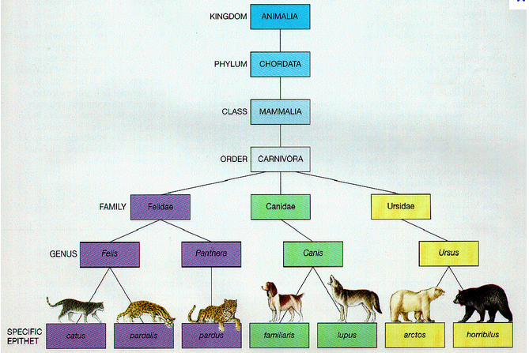
Inheritance

Slide 19
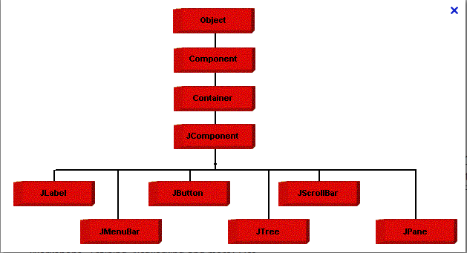
Example of Inheritance in the Java Class Hierarchy

Slide 20
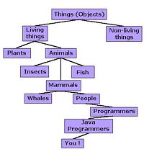

Slide 21
